Slide 1
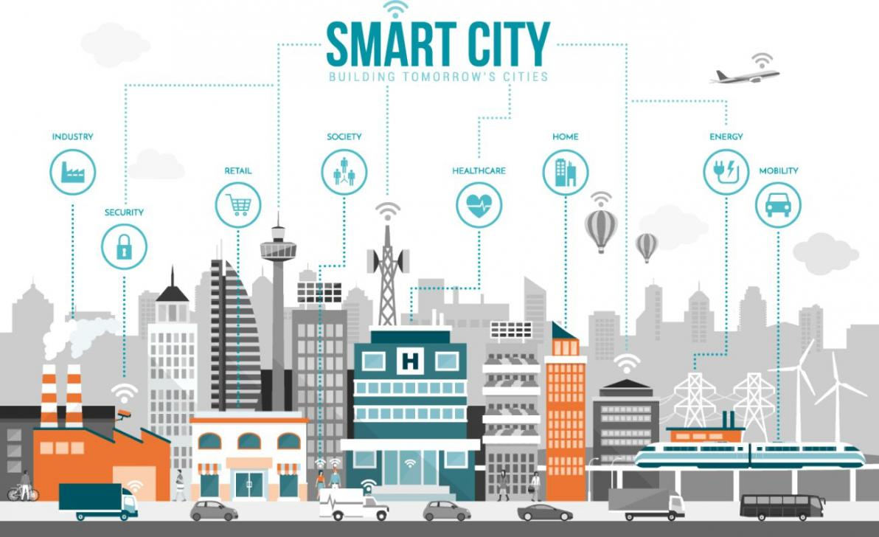
Brian Allen, Marcus Kwong, Tarun Singh, Hui-Yu Sim

Slide 2

Introduction
What is smart city?
Topics that we will be talking about
Infrastructure
Environmental
Internet of Things
Economics
Notes:
Our first thought of smart city is analyze a large data that can be automated, which is somewhat correct, because after thorough research we found that Smart city is how can we improve the quality of life in the city, improve infrastructures, and economic savings. To do we need to gather and analyze large amount of data. Most of the data that gather is by deploying sensors in a small region of the city that would last between 6-12 months long depending on the project and funds. With population on the rise and more people moving towards the urban area, more and more challenges are becoming more apparent in the city. There are 4 main topics that our group will be talking about, infrastructure, environmental, internet of things and economics.

Slide 3
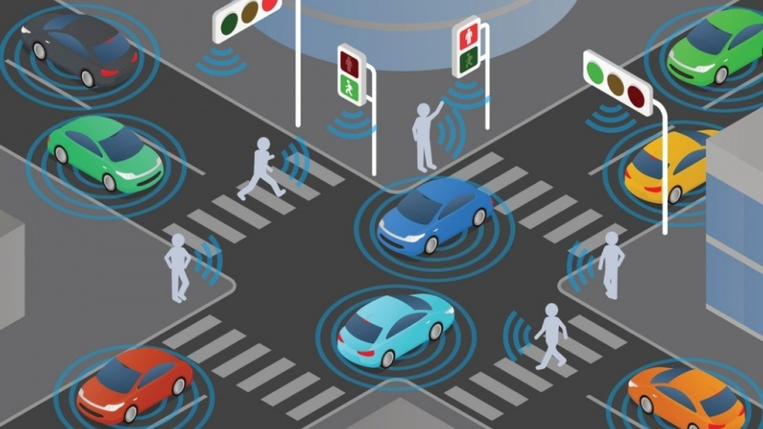
Infrastructure
Understanding The Issues:
Traffic Delays
Congestion
Traffic Safety
Development & Support of EVs
And more...
Notes:
Regarding Smart cities, a large focus in development is in regard to transportation management within and around the city. Columbus OH mayor Andrew Ginther said in an interview regarding smart cities “Transportation is not just about roads, transit and ride-sharing. It’s about how people access opportunity and how they live”¹. If you can’t get to work, you can’t make that money.
When looking at the topic of infrastructure, this can be encompass transit, roads, transportation, and even overlap other topics regarding economics and environment. For the purposes of this presentation, I will be covering the specific areas regarding all things transportation.
Throughout my research, I found some common issues that many cities were currently developing. These issues included:
1. Traffic delays
2. Congestion
3. Public Safety
4. Development and support of Electric Vehicles (EVs)
These issues are common amongst any growing major city and is a point of importance for maintaining an efficient and safe environment for day to day movement into and around the city. Identifying these issues, let’s take a look at some of the ideas that have been developed to address these issues.

Slide 4
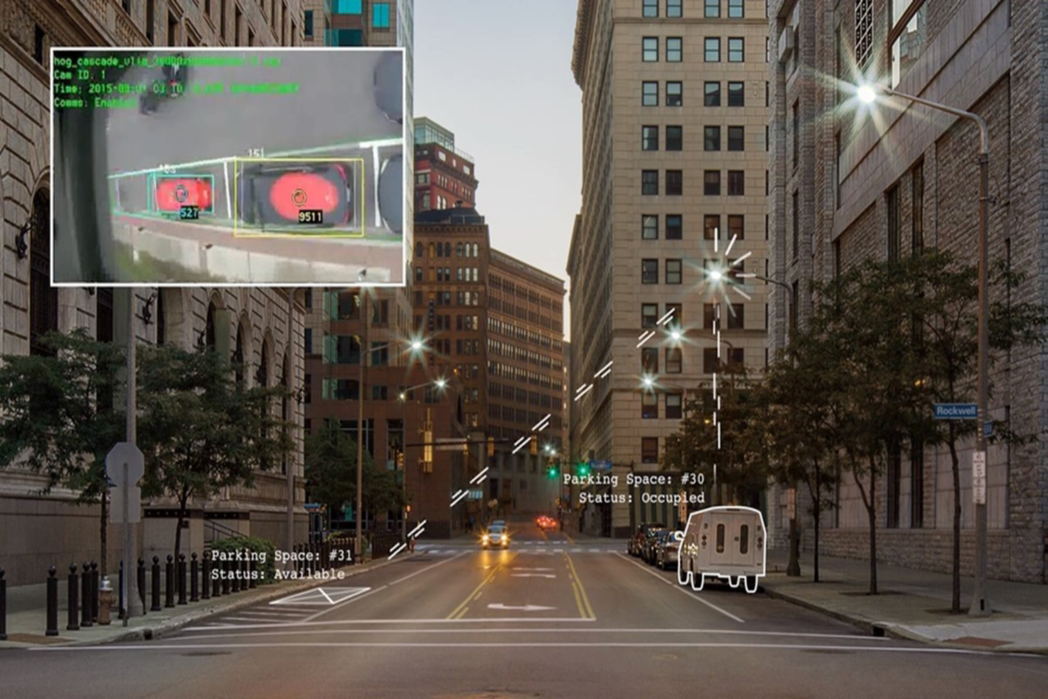
Addressing Traffic Congestion:
Traffic Safety Sensor Project
Portland, OR: Traffic Safety Sensor Project
GE’s CityIQ platform
Tracking traffic, pedestrian and bicycle patterns along 3 problem areas in Portland
Goal is to optimize traffic flow
System also being implemented in:
San Diego, CA
Atlanta, GA
Others
Notes:
Let’s first examine a current project happening here in Portland, the Traffic Safety Sensor Project². Led by the Portland Bureau of Transportation (PBOT) and Bureau of Planning and Sustainability (BPS), this project was an initiative to deploy new sensor technology to street lights in order to gather data regarding how people are traveling and where potential danger areas may be.
Installed in June 18 2018³, CityIQ nodes were installed along 3 of Portland’s most dangerous streets, measured by high crash rates. These were along SE 122nd Ave, SE Hawthorne Blvd, and SE Division St.
What’s innovative about this project is that Portland is using sensors that give real-time video analysis to collect vehicle, bicycle and pedestrian data. The goal is to gather accurate data about pedestrian movement, parking data and environmental data extraction³.
The sensor system developed by GE is called current by GE’s CityIQ⁴. The CityIQ platform is a digital infrastructure placed on streetlights and/or street lamp posts that gathers real-time data and uses computer vision to help optimize traffic, bicycle and pedestrian planning.
How it works: An example for traffic planning API, it provides vehicle metadata collected from the intelligent nodes installed along the roadways. As vehicles pass by these sensors, information such as speed, direction, volume (# vehicles) and vehicle classification is collected and stored with a timestamp in the cloud⁵. The system looks at traffic patterns at different intervals. The overall analysis aims to plan for future safety and optimize traffic flows.

Slide 5
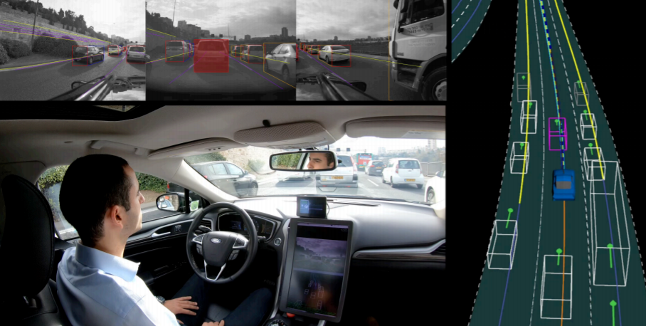
Addressing Traffic Safety: Mobileye
Detecting pedestrians, bicycles, other vehicles to avoid collisions
Developed by Intel
Vehicle-to-Infrastructure (V2I)
Vehicle-to-Pedestrian (V2P)
Implementations on transit buses
Ex. Kansas City, MO
Deployed on 300 City Buses
Ex. Seattle, WA
58% reduction in vehicular and pedestrian collision claims
Notes:
Alongside optimizing traffic flow throughout the city, another development is regarding traffic safety. An application developed by Intel called Mobileye aims to do just that.
One example of this implementation can be found in Kansas City MO, where Kansas City Area Transportation Authority (KCATA) deployed Mobileye on 300 city buses in 2016. These sensors worked by detecting pedestrians and cyclists to prevent collisions⁶. The in-vehicle warning application alerts the bus operator when pedestrians are within the intended path of the bus.
This was part of Kansas City’s smart city challenge, and although the annual pedestrian accident numbers fell between 2016 to 2017, it then rose again in 2018, perhaps showing that further expansion into this development is needed.
Another City implementing this system is Seattle, WA⁷. According to a report done in May 2017, the Innovations Deserving Exploratory Analysis Programs (IDEA) Program Final Report listed the number of bus collisions (motor, commuter, trolley) at 70,302 with 1,198 fatalities.
In an effort to reduce these collisions, the Rosco VQS4560 Mobileye Shield+ System was installed for use on transit buses. The system is a collisions avoidance warning system (CAWS), which included 4 cameras (a master on the inside windshield, a camera attached to the inside windshield positioned to cover the blind zone on left front created by the “A” pillar, and one external forward-facing camera on each side of the bus towards the rear to cover blind zones behind the driver)⁷. The project
In January 2nd 2019, a study showed that this Mobileye Shield+ system had benefits⁸. Reports showed that buses equipped with this system had a 58% reduction in vehicular and pedestrian collision claims.

Slide 6
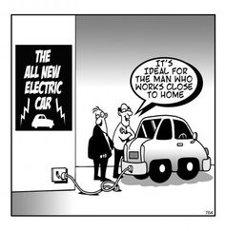
Adoption and Support for Electric Vehicles (EVs)
Range anxiety and lack of charging locations
Installation of higher power DCFC stations
Adding more away-from-home charging stations
Targeting desirable charging location
Notes:
Electric cars are a rapidly growing industry in the U.S. For its environmental benefits, cities have been trying to implement solutions to encourage the use of EVs for both government use and public use. During the Smart City challenge in 2016, a number of cities made plans to adopt EV usage in different ways. In Kansas City, MO and Portland, OR, there was a plan to convert public fleet vehicles to EVs. In Columbus, OH and Denver, CO, the installation of more plug-in charging stations was pursued.

Slide 7
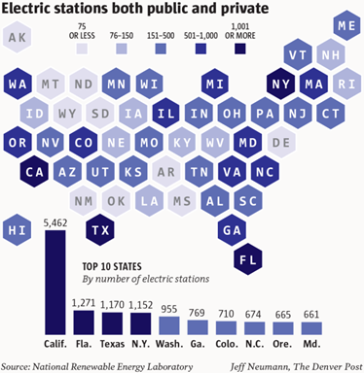
Plug-In Charging Stations

Slide 8
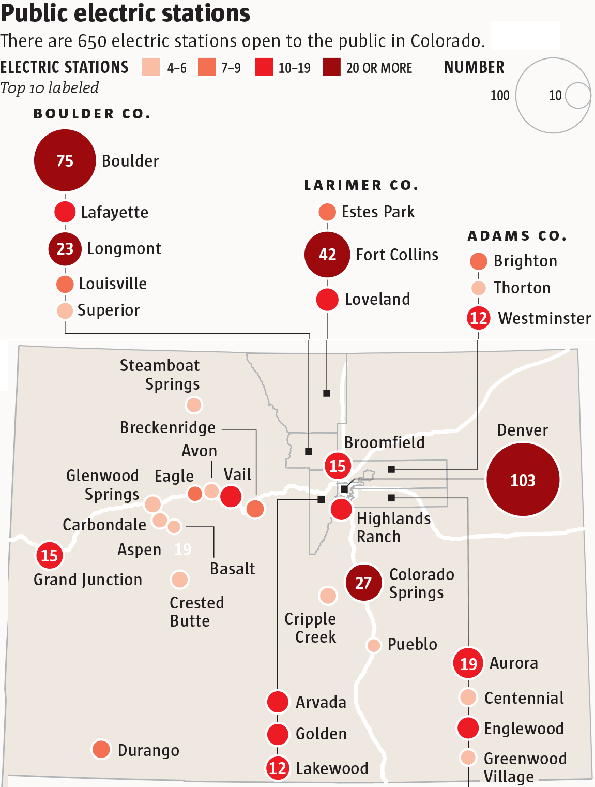
Notes:
Let’s look deeper into Denver Colorado, which is an example of a city that is trying to install more plug-in charging stations. In 2017, Colorado received $68.7 million from the Volkswagen settlement¹⁰. Of these newly acquired funds, $18 million was to be focused on replacing heavy- and medium-duty trucks (including shuttle buses and school buses) with new alternative-fuel vehicles. Also, $10.3 million was to be used to pay for electric vehicle charging stations.
So, the real crux of the issue is now “where to place these plug-in charging stations?”. Some aspects to consider: can an energy grid support the placement of plug-in charging stations? How many can we place? What is the optimal position of charging stations to maximize usage/distance?
Plug-in electric vehicle charging equipment are classified by the rate at which they charge batteries. There are 3 levels (AC Lvl 1, AC Lvl 2, DC fast charging).¹¹

Slide 9
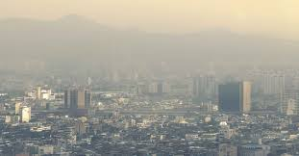
Air Quality Sensor
Current problem
More than 4.2 million people worldwide die each year due to air pollution
91% of world’s population lives in places where air quality exceeds world health organization’s guideline limits
Not much information for the localized air quality
Localized air quality is measured in smaller scale environment
Notes:
Problem:
According to world health organization, roughly 4.2 million people worldwide die each year due to air pollution and many of these deaths occurs in large cities. Right now 91% of the world’s population live in places where the air quality exceed the guideline limits. Long exposure to polluted airs can develop diseases such as heart and lung diseases and it can also worsen any existing medical conditions. Right now there are no localized air quality information where citizens can decide if they should be indoor to avoid exposure of polluted air. If people have these information they can be better informed and take actions.
resources :
https://www.govtech.com/fs/infrastructure/Air-Quality-Sensor-Pilot-Offers-Lessons-for-Other-IoT-Installations.html
https://static1.squarespace.com/static/5967c18bff7c50a0244ff42c/t/5ad7c41c758d464041c7e58a/1524089886422/Distributed_Sensor_Networks_Recommendations.pdf

Slide 10
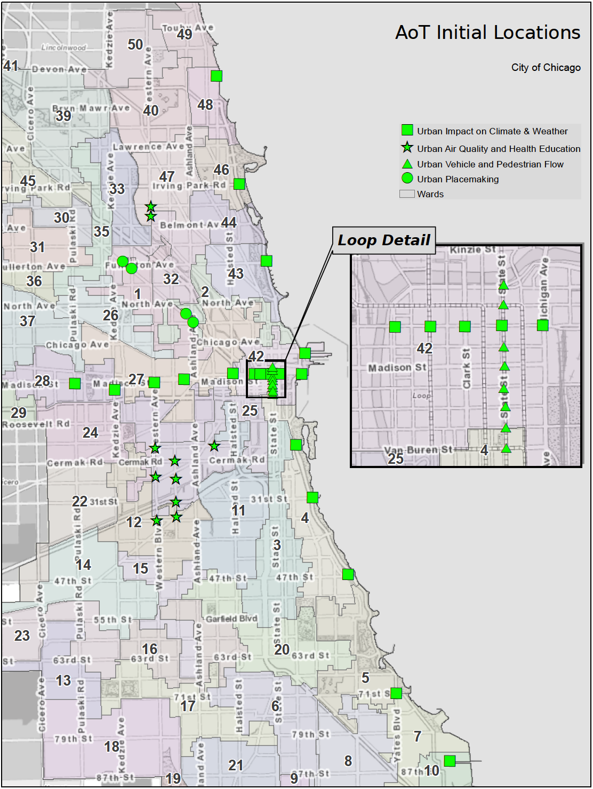
Air Quality Sensor
Current Solution
Chicago’s project: The Array of Things
Data is open, free and available to the public
Things to can be done with this data
Suggest safe and efficient routes for pedestrians walking late at night and during peak traffic
Suggesting the healthiest and unhealthiest walking times and route through the city
Real-time detection of urban flooding
Up-to-date, “block-by-block” weather and climate information
Notes:
Current Solution: Back in 2014, Chicago started a project call “The Array of Things”. They’ve deployed 50 high-quality sensors in a small part of Chicago to gather data that can provide instantaneous air quality information. By getting these instantaneous data, cities can send a warning message to the citizen during poor air quality in real-time. By deploying these sensors to gather data, these data can be used to suggest safe and healthiest routes for pedestrians, real-time detection of urban flooding, and real-time weather and climate information.
As of March 2019, there are roughly 100 sensors operating throughout Chicago and they are planned on installing additional 100 sensors between March-June of 2019. However, each one of these sensors cost around $5000 and not every city will be able to deploy that many expensive sensor throughout the city so they turn to looking at using low-cost sensors. Portland is one of the city that has started a project to test low-cost air quality sensors to determine if they can provide accurate information to the public.
Resources:
https://arrayofthings.github.io/

Slide 11

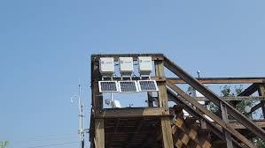
Air Quality Sensor
Future Solution
Deploy low-cost sensors to determine if these sensors can provide reliable air quality data
Deploying sensor to three types of location
Known concentration of gases and particles
Urban ambient monitoring station
Intersections on a major urban roadway
Notes:
Solution: In 2018 Portland has started the project to deploy low-cost sensors to three types of co-located deployments:
Testing sensors against known concentration of gases and particles in the STAR (Sustainable atmospheres research) Lab at PSU
Co-locating sensors together at an oregon department of environmental quality urban ambient monitoring station
Co-locating different types of sensors at intersection on a major urban roadway
Currently the pilot is still in progress as of 2018, don’t have any information on 2019. But their next step is to document the maintenance required once devices are installed. Also planning on what is the best way to communicate short-term air quality measurements to the public. Once the data are gather we also want to see the air quality accuracy between the low-cost and high-cost sensors.
Resources: https://www.govtech.com/fs/infrastructure/Air-Quality-Sensor-Pilot-Offers-Lessons-for-Other-IoT-Installations.html

Slide 12
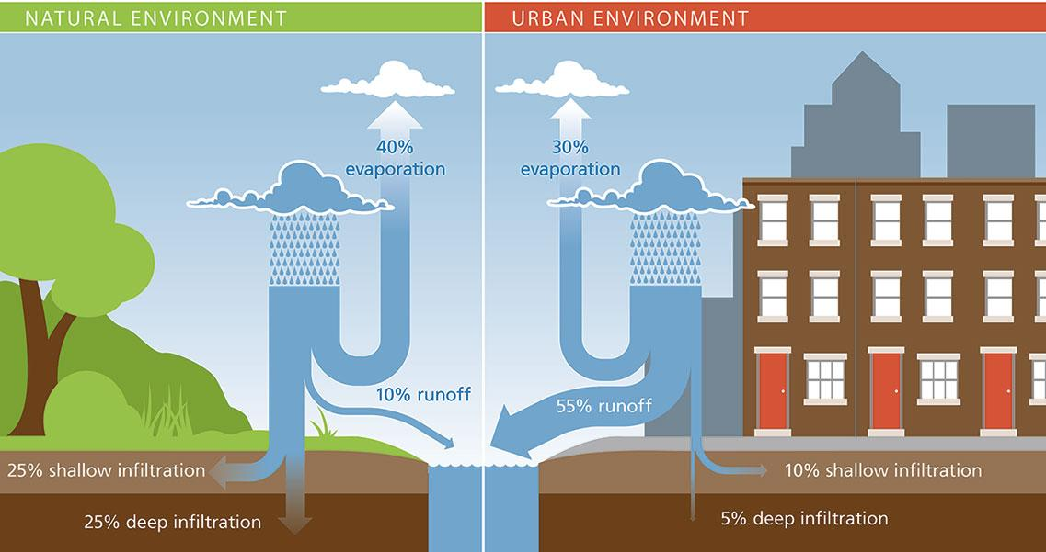
Stormwater runoff
Current problem
Water pollution in urban areas
stormwater runoff not soak to the ground
Stormwater runoff carries trash, bacteria, and other pollutants to sewer and then to near by water.
Heavy rain can cause erosion and flooding
Notes:
Current Problem:
Sensors can also be used to gather information on stormwater but let’s look at the problem first. Stormwater runoff is a major cause of water pollution in urban areas. When rain falls on roofs, streets, and parking lots the water cannot soak into the ground as it should. Stormwater drains through gutters, storm sewers, and other engineered collection systems and is discharged into nearby water. The stormwater runoff carries trash, bacteria, heavy metals, and other pollutants from the urban landscape. If we have heavy rains then it can cause erosion and flooding that would damage property, and infrastructure.
Comparing to natural environments the water is absorbed and filtered by soil and plants which is much cleaner and less of a problem compared to urban environment.
Resources: https://www.waterworld.com/international/wastewater/article/16190746/smart-water-a-key-building-block-of-the-smart-city-of-the-future
https://www.creatingsmartcities.es/en/smartareas-water.php
https://www.environmentalleader.com/2018/04/water-wise-the-role-of-water-management-in-the-smart-city-revolution/

Slide 13
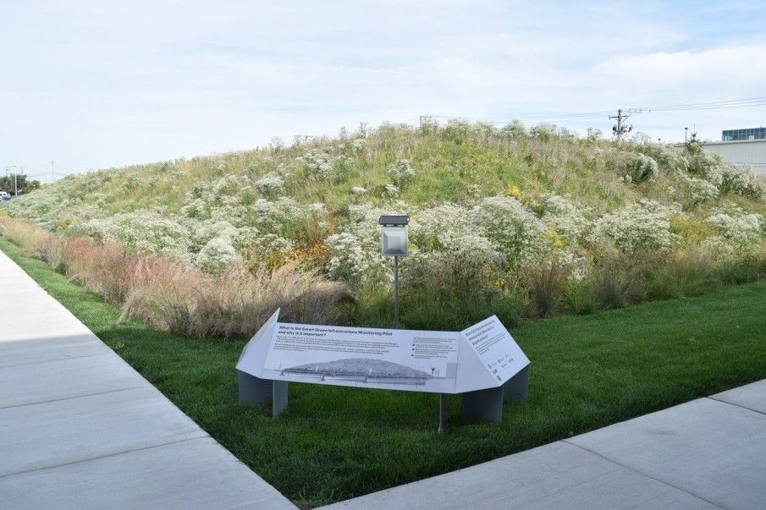
Stormwater runoff
Current Solution
Green infrastructure
Wetlands
Forest
Rain garden
Green roofs
Trees and tree boxes
Challenges
Monitoring
Might need more than green infrastructure for other areas
Notes:
Current Solution: Currently the easy solution is to incorporate green infrastructure to the urban area. Green infrastructure is a solution that help protect and restore the natural water cycle. Green infrastructure include wetlands, forest, rain garden, green roofs, trees and tree boxes. By incorporating green infrastructure, cities wouldn’t have to build a new water treatment plant which cost much way more. Currently many cities are already embracing the green infrastructure, places like new york, chicago, portland, seattle, san francisco and many others.
Even though green infrastructure does help reduce stormwater runoff, it still face many challenges. Some locations have more severe weather than others so but randomly installing green infrastructure in the urban area might cause more problem than a solution. There is no monitoring for these type of data, so by incorporating green infrastructure randomly around the city will not be as efficient as if we can pinpoint location where it is most needed to reduce stormwater runoff.
Resources:

Slide 14
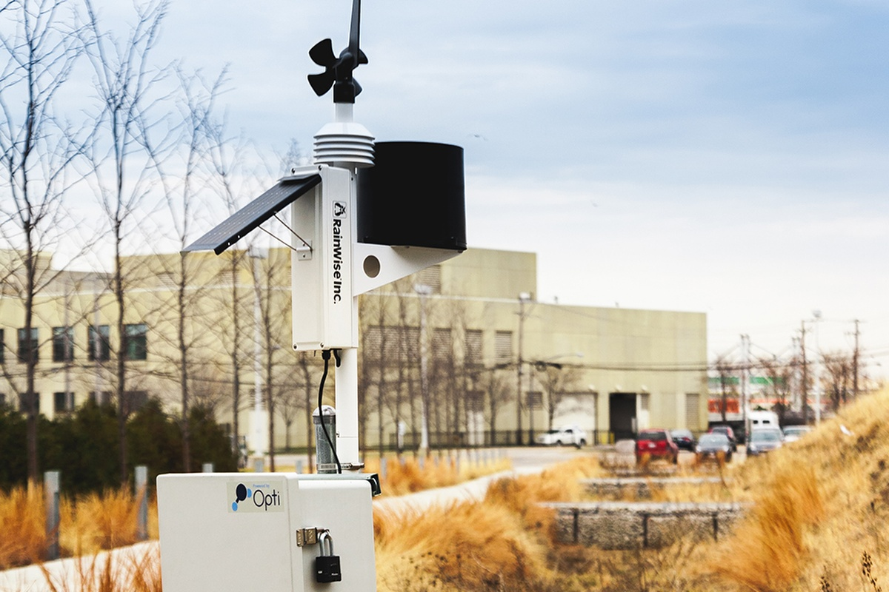
Stormwater runoff
Future Solution
Installing low-cost sensors
Monitor if it is entering infrastructure as intended
Determine where the water goes once it enter the infrastructure
Check soil moisture, chemical rates and water quality.
Notes:
Future solution:
In 2016 Chicago has installed low cost sensors throughout the city to evaluate the city’s current green infrastructure. The goal of these sensor is to monitor whether or not the stormwater are entering the green infrastructure with the help of weather monitoring information. The sensor will also monitor soil moisture, chemical absorption rates, and water quality to determine if the green infrastructure is managing the water as intended.
Ultimately, the purpose is not only to determine if the green infrastructure is working but where and when certain types of green infrastructure are most effective. Specifically, whether the green infrastructure is preventing stormwater from entering the sewer system and what green designs work best for different types of rain and length of the storm.
Resources: https://www.waterworld.com/international/wastewater/article/16190746/smart-water-a-key-building-block-of-the-smart-city-of-the-future
https://datasmart.ash.harvard.edu/news/article/how-a-smart-city-tackles-rainfall-956
http://duwaterlawreview.com/cities-explore-future-urban-stormwater/
https://www.creatingsmartcities.es/en/smartareas-water.php
https://www.environmentalleader.com/2018/04/water-wise-the-role-of-water-management-in-the-smart-city-revolution/

Slide 15
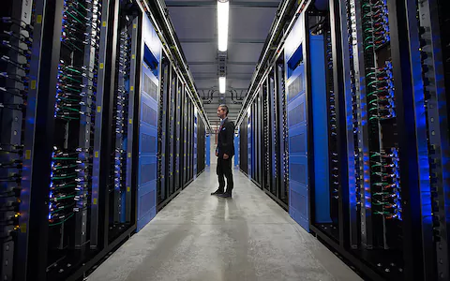
Central Data IoT
Projects
Privacy Policies
Types of Data
Notes:
Problem: Where does all the data go? What types of data do we keep?

Slide 16
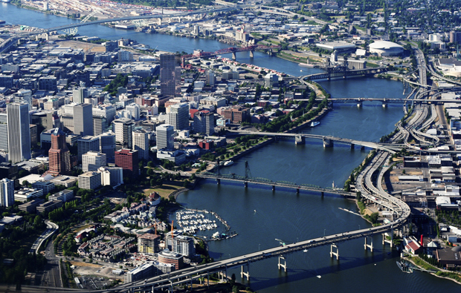
Portland Urban Data Lake
Open data policy
Partners and projects
Privacy policy
Notes:
In 2009, Portland became the first city in the United States to adopt an Open Data Resolution (Resolution No. 36735) to encourage the expansion of the technological community by promoting open data and partnerships between City government and the public, private and nonprofit sectors, academia, and labor.
In May of 2017, Portland formally adopted an Open Data Policy and Program (Ordinance 188356) to expand upon the work completed as a part of the 2009 Resolution, establishing mechanisms for engaging all City bureaus in the proactive collection and distribution of City data. The ordinance establishes Open Data Policy to be committed to the publication, accessibility, and equitable and widespread sharing of data collected and generated by all City bureaus and by private sector companies, non-profit organizations, academic universities and other parties working on behalf of the City. The City will also strive to make data open by default.
The City has partnered with PSU, TriMet, Metro, Portland General Electric, Hack Oregon and others to develop PUDL as a regional resource.
GOALS
Collect and store data from a variety of sources, including new sensor deployments, PBOT and BPS data sources as well as other regional data sources, while respecting privacy and security needs.
Develop analytics that create new insight from these data sources, and to demonstrate the effective use of Smart Cities data.
Explore technologies and architectures for providing standardized, documented access to data for public sector agencies and local innovators.
Data openness – Data, metadata and information managed by the City of Portland -- and by third parties working on behalf of the City -- that are made accessible to the public must comply with all applicable legal requirements and not expose any confidential, restricted, private, Personal Information or aggregated data that may put communities, individuals, or sensitive assets at risk.

Slide 17
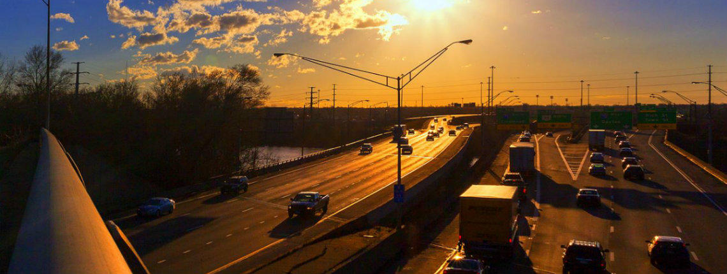
Smart Columbus Operating System
Majority of data used for transportation
Projects of note
Odd privacy statements
Notes:
SCOS (Smart Columbus Operating System)
Can actually look at data sets
Most is centered around mobility
Child Mortality
First Last Mile
Food Pantries
We will not rent, sell, or provide any Internet information identifying you individually (name, address, phone, number, etc.) to third-parties for marketing or mailing lists. We will not send you unsolicited e-mail regarding any commercial offers or advertisements at any time.
Some information that you submit to us through this website may be protected by encryption technology, whereas other information may not. Unless a particular web page on this site indicates that encryption technology is being used, you should not assume that information you submit through that web page will be secure. If you submit information to our server through a web page containing visible indicators of active encryption technology, we will take reasonable precautions to safeguard the confidentiality of such information.
Data sets now available within the operating system include:
Geographic density of older residents
Geographic distribution of vulnerable older residents
COTA transit schedules and routes
COTA one – minute refresh GPS data (archived and dynamic)
Sidewalk existance maps from MORPC
Sidewalk condition data
Crosswalk types and facilities
Traffic/crossing signal cycles and timing
Locations of healthcare services, food services, shopping destinations and more (Only non traffic)

Slide 18
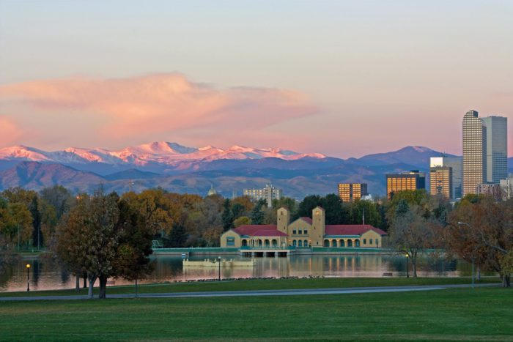
Denver Enterprise Data Management System
Public and private data
Projects are with private companies
Privacy
Notes:
Enterprise Data Management System (Denver).
Denver’s data management system is being constructed to support Denver Smart City portfolios and projects. Built for integration and interoperability, the IoT platform compiles real-time data on transportation, environmental health, weather, and freight. This drives smarter decision-making, emphasizing safety and security.
BlueTOAD
"BlueTOAD is an advanced technology to directly determine travel times and road speeds by matching detections of anonymous Bluetooth signals emanating from passing vehicles.
Canary by Lunar Outpost
The Canary is the next step in real-time, miniaturized air quality sensor systems.
Econolite Cobalt
"The traffic signal controller represents one of the most important intelligent technology and communication components of a signalized intersection.
Privacy
Businesses and agencies must have a written policy explaining how they will dispose of the personal information they keep and follow through on those procedures.
If a data breach is detected, entities must alert consumers that their data has been compromised within 30 days. If more than 500 Coloradans are impacted, the entity must alert the attorney general’s office.
Entities must take “reasonable” steps to protect the personal information they keep.
Canary by Lunar Outpost
The Canary is the next step in real-time, miniaturized air quality sensor systems.
Econolite Cobalt
"The traffic signal controller represents one of the most important intelligent technology and communication components of a signalized intersection.
Privacy
Businesses and agencies must have a written policy explaining how they will dispose of the personal information they keep and follow through on those procedures.

Slide 19
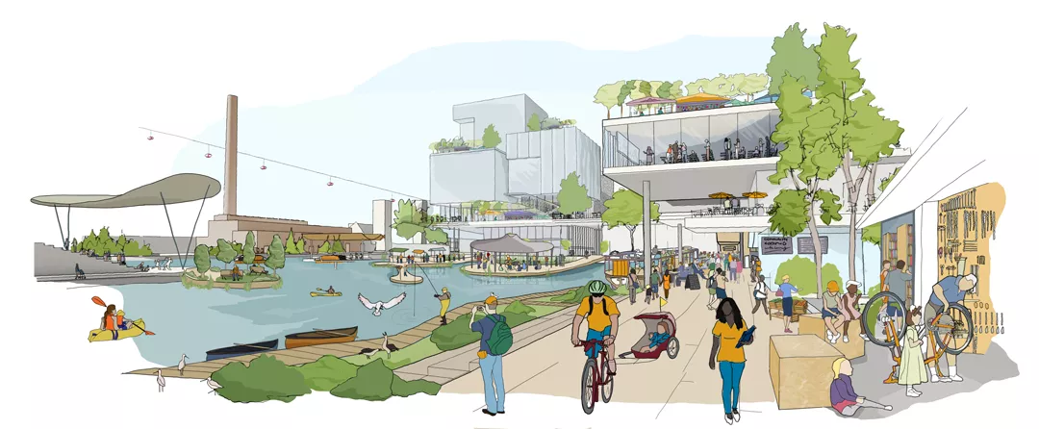
Toronto and More
Third-party “data trust”
Privatization
Other thoughts
Notes:
Talk about a few of Toronto’s blocking problems-- privacy and privatization
Other cities and central data. Seattle. Austin.

Slide 20
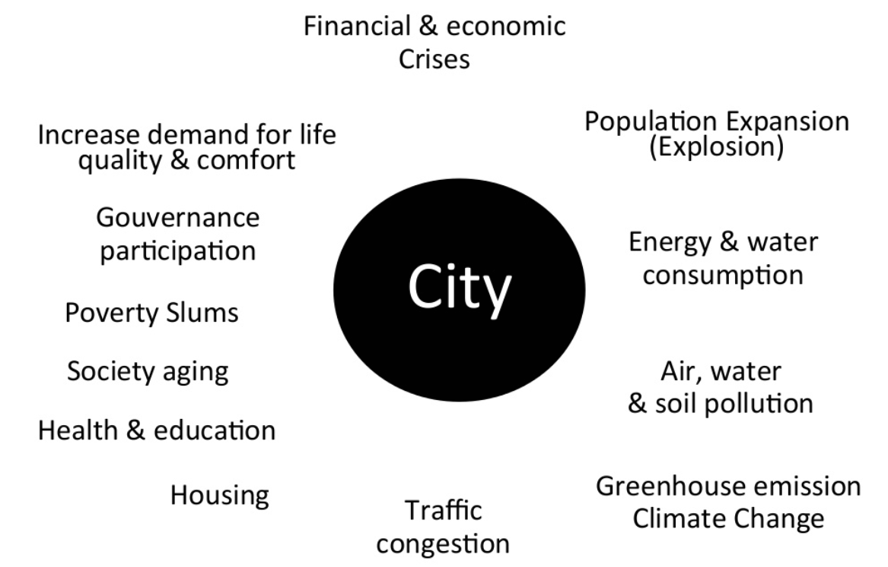
Economical
Problems
Without the right vision, plans, talent, and funding in place, smart city programmes will not reach their full potential.

Slide 21


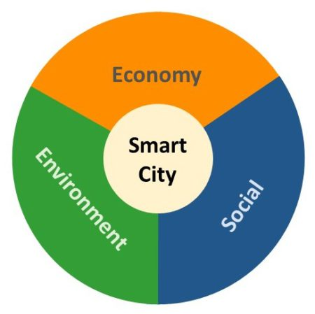

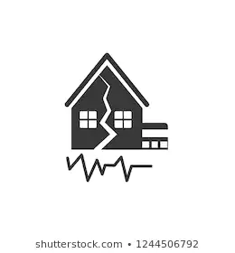

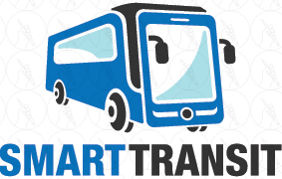
Economic Development
Automation brings in cost savings
Sensors ensuring proper efficiency
Mitigating risks, reducing damages
More inflow of talent
Smart transportation

Slide 22

Positive Impacts
Foster entrepreneurs to develop the technology needed and the companies needed to implement the advance technology.
Private companies are collaborating and the result will be seen in enhanced Internet availability, energy savings and improved connectivity with citizens.
Diminishing air-pollution levels and improves citizen’s physical and mental health, but also saves public funds.
Smart grids allow governments to better prepare for power outages and even use electric vehicles as power sources in times of shortage.
Using IoT solutions to more effectively implement road tolling systems and cut down parking fraud.
5G mobile networks are also increasingly improving companies digital operations and allowing them to work with a more varied international network.

Slide 23
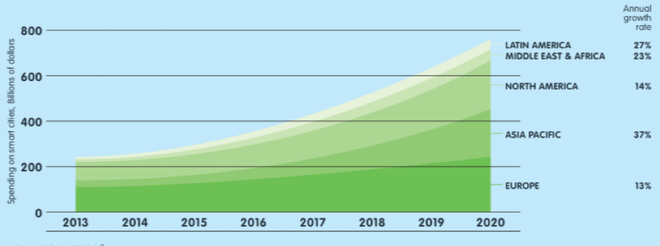
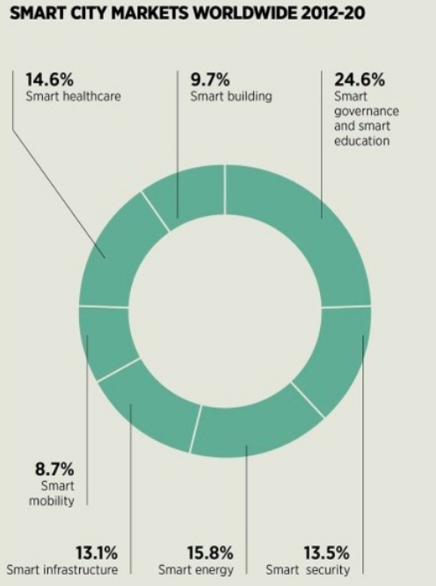
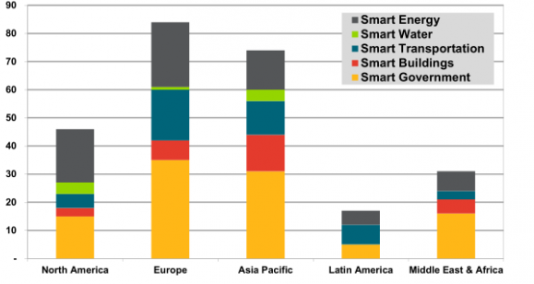
Investment Flow
Expenditure
Effective Growth

Slide 24
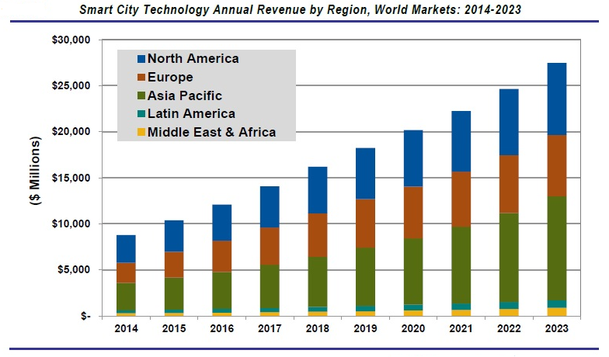

R
E
V
E
N
U E

Slide 25
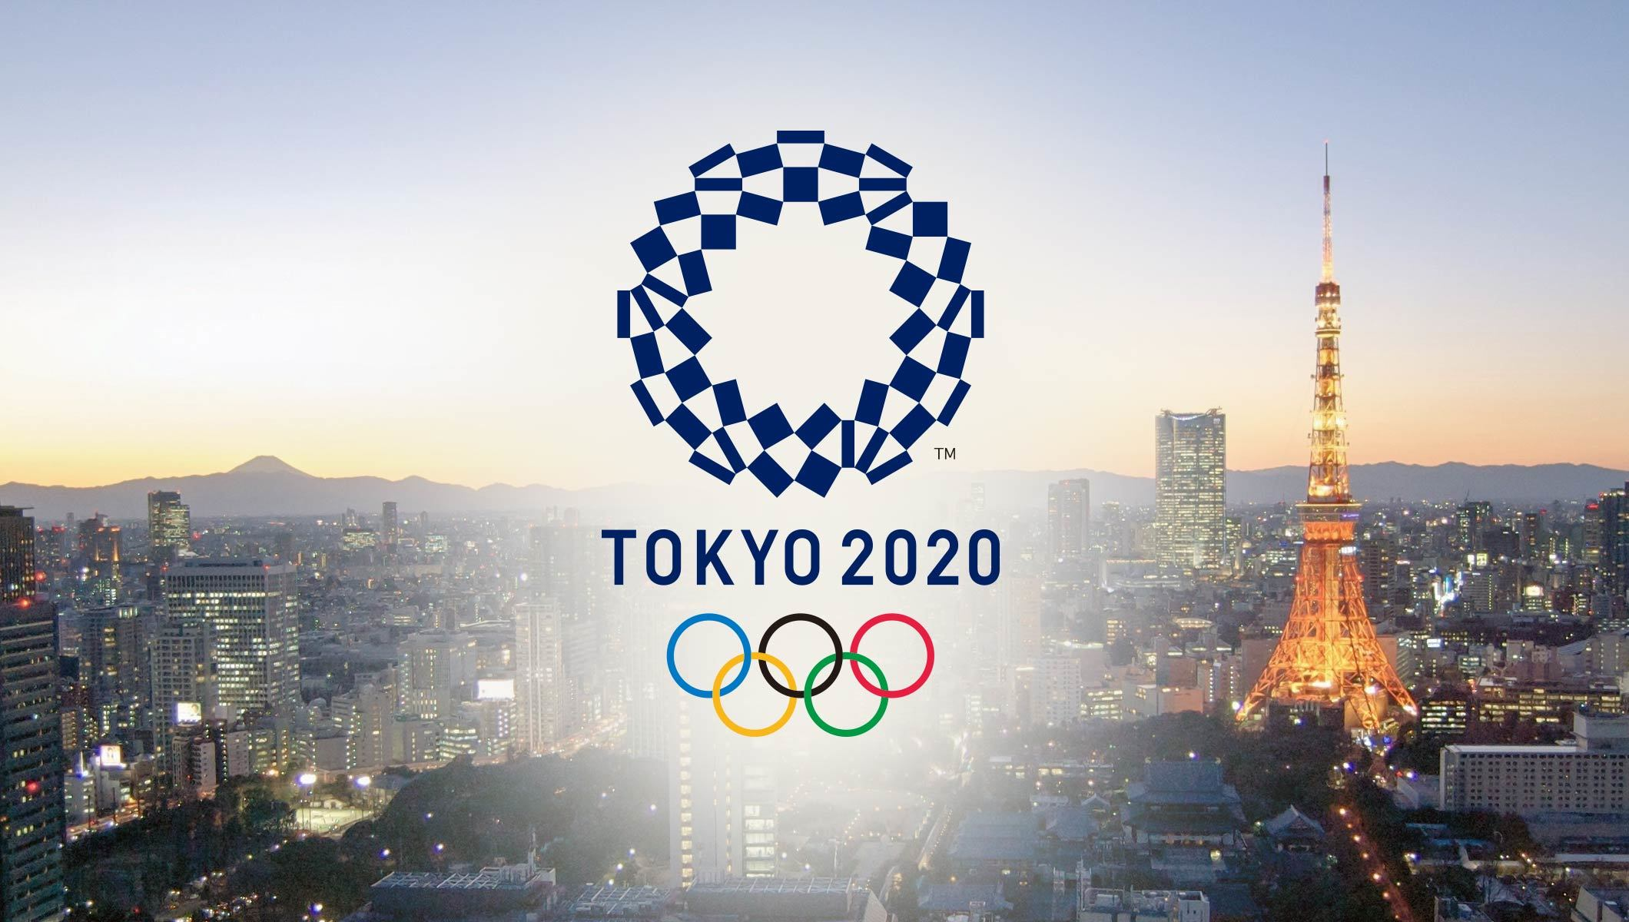
Example
Foreign-language signs are increasingly common along streets.
Cashless payment is becoming available at more shops.
Restaurants and ashtrays are vanishing from public spaces.
Curb indoor smoking under a health promotion law.
Subway stations run by Tokyo Metro Co. started accepting Alipay, the mobile payment system.
Public transportation companies and businesses at major tourist spots are catching up
Preparations for 2020 Tokyo Olympics transforming capital into 'global standard' city.

Slide 26
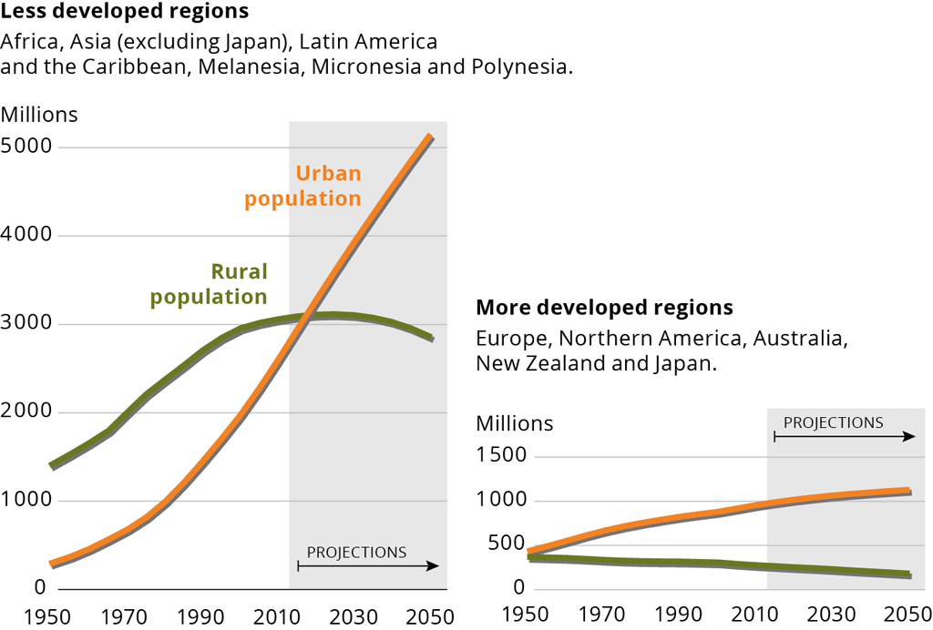
Conclusion
60% of the world’s population are expected to live in the cities by 2050
Start developing solutions
Emergent Field
Hype Cycle
Notes:
Resource: https://www.techrepublic.com/article/smart-cities-the-smart-persons-guide/

Slide 27
Discussion
From the presentation, what project do you think is practical?
Why you think its practical?
Which one is not practical?
Is there a better solution?
What are the greatest challenges facing smart city implementations?
What are other ideas that can help smart city?

Slide 28
Discussion
From the presentation, what project do you think is practical?
Why you think its practical?
Which one is not practical?
Is there a better solution?
What are the greatest challenges facing smart city implementations?
What are other ideas that can help smart city?
Smart energy/water
Real time information
Reduce heat
Smart waste
Pay to throw away trash?
Smart implementation of grocery stores
Help all group of people

Slide 29
References
Environmental:
“Air Quality Sensor Pilot Offers Lessons for Other IoT Installations.” Government Technology State & Local Articles - E.Republic, www.govtech.com/fs/infrastructure/Air-Quality-Sensor-Pilot-Offers-Lessons-for-Other-IoT-Installations.html.
Christine Kendrick, Andrew Rodgers, “Recommendations for the Development % implementation of distributed sensor network,” https://static1.squarespace.com/static/5967c18bff7c50a0244ff42c/t/5ad7c41c758d464041c7e58a/1524089886422/Distributed_Sensor_Networks_Recommendations.pdf
“Smart Water: A Key Building Block of the Smart City of the Future.” WaterWorld, 9 Dec. 2013, www.waterworld.com/international/wastewater/article/16190746/smart-water-a-key-building-block-of-the-smart-city-of-the-future.
“Smart City: Water.” Smart City Areas: Water, www.creatingsmartcities.es/en/smartareas-water.php
“Smart Water: A Key Building Block of the Smart City of the Future.” WaterWorld, 9 Dec. 2013, www.waterworld.com/international/wastewater/article/16190746/smart-water-a-key-building-block-of-the-smart-city-of-the-future.
https://datasmart.ash.harvard.edu/news/article/how-a-smart-city-tackles-rainfall-956
http://duwaterlawreview.com/cities-explore-future-urban-stormwater/

Slide 30
References
Environmental:
“How a Smart City Tackles Rainfall.” Data, datasmart.ash.harvard.edu/news/article/how-a-smart-city-tackles-rainfall-956.
“Cities Explore the Future of Urban Stormwater.” University of Denver Water Law Review at the Sturm College of Law, 21 Nov. 2017, duwaterlawreview.com/cities-explore-future-urban-stormwater/.

Slide 31
References
Infrastructure:
Columbus, OH Transportation project https://www.columbus.gov/smartcity/
Portland OR Traffic Safety Sensor Project https://www.smartcitypdx.com/traffic-safety-sensor-project
Portland OR Traffic Safety Sensor Project govtech https://www.govtech.com/fs/infrastructure/Portland-Launches-Road-Safety-Sensor-Pilot.html
GE Sensor Current system https://developer.currentbyge.com/cityiq
CityIQ Traffic API https://docs.cityiq.io/#03-Traffic%20API/Traffic%20Planning%20API.htm%3FTocPath%3DTraffic%2520Planning%2520API%7C_____1
Kansas City MO Mobileye https://cms.dot.gov/sites/dot.gov/files/docs/Kansas-City-SCC-Technical-Application.pdf
Seattle WA Mobileye file:///C:/Users/MKwon/Downloads/VRU-Proxi-05-11%20(Israel)%20WSTIP_ActiveSafety-CollisionWarningPilot.pdf
Washington State benefits of Mobileye shield+ https://blog.mobileye.com/na/shield-study-blindspot-detection?ref=Welcome.AI
Actual WA Mobileye shield+ report https://go.mobileye.com/hubfs/WTSIP_Study%20Summary-final.pdf
Colorado Volkswagen funds for EVs https://www.govtech.com/fs/Colorado-Will-Use-Settlement-Money-from-VW-to-Replace-Older-Vehicles-Fund-EV-Charging-Stations.html
Infrastructure for plug-in charging stations https://afdc.energy.gov/fuels/electricity_infrastructure.html

Slide 32
References
Centralized data
IOT Platform, www.denvergov.org/content/denvergov/en/denver-smart-city/iot-platform.html.
Bliss, Laura, and Laura Bliss. “A Big Master Plan for Google's Growing Smart City.” CityLab, 27 June 2019, www.citylab.com/solutions/2019/06/alphabet-sidewalk-labs-toronto-quayside-smart-city-google/592453/.
Cecco, Leyland. “'Surveillance Capitalism': Critic Urges Toronto to Abandon Smart City Project.” The Guardian, Guardian News and Media, 6 June 2019, www.theguardian.com/cities/2019/jun/06/toronto-smart-city-google-project-privacy-concerns.
“Smart City PDX.” Smart City PDX, www.smartcitypdx.com/.
“The Promise and Potential Pitfalls of Google's Smart City in Toronto.” The Urbanist, 28 Feb. 2019, www.theurbanist.org/2019/02/28/the-promise-and-potential-pitfalls-of-googles-smart-city-in-toronto/.
“Welcome to Smart Columbus.” Smart Columbus OS, www.smartcolumbusos.com/.

Slide 33
References
Centralized Data
“Smart City PDX.” Smart City PDX, www.smartcitypdx.com/.
“The Promise and Potential Pitfalls of Google's Smart City in Toronto.” The Urbanist, 28 Feb. 2019, www.theurbanist.org/2019/02/28/the-promise-and-potential-pitfalls-of-googles-smart-city-in-toronto/.
“Welcome to Smart Columbus.” Smart Columbus OS, www.smartcolumbusos.com/.
Lazaroiu, G. C., & Roscia, M. (2012). Definition methodology for the smart cities model. Energy,47(1), 326-332. doi:10.1016/j.energy.2012.09.028

Slide 34
References
Economic Development
https://smartcitiescouncil.com/smart-cities-information-center/economic-development
https://scholars.fhsu.edu/cgi/viewcontent.cgi?article=1500&context=theses
https://www.smartcitiesworld.net/news/news/how-smart-city-investment-can-unlock-economic-growth-3566

